Slide 1
Employee Data Analysis using Excel
STUDENT NAME: S.Mythili
REGISTER NO: 2213331042121
DEPARTMENT: Commerce
COLLEGE: Bharathi women's college

Slide 2
PROJECT TITLE
Employee Attendance Analysis using Excel

Slide 3


AGENDA
Problem Statement
Project Overview
End Users
Our Solution and Proposition
Dataset Description
Modelling Approach
Results and Discussion
Conclusion
3/21/2024 Annual Review

Slide 4

PROBLEM STATEMENT
"Analyze employee attendance data to identify trends and patterns, calculate key metrics such as attendance percentage and average hours worked, and create visual reports to support decision-making related to workforce management."

Slide 5

PROJECT OVERVIEW
The project aim to analyse employee attendance data using excel to identify trend and area for improvement. By organizing data,calculating key metrics,and visualizing trend throught chart and pivot table,the project seek to uncover pattern in attendance behaviour.The ultimate goal is to enhance workforce management by providing actional insight into employee attendance trend and optimizing attendance practices.
.

Slide 6

WHO ARE THE END USERS?
1.HR Managers : To monitor and improve attendance practice and address issues.
2.Department Head : To track team attendance and identify pattern affecting productivity.
3.Executives : To access overall workforce trends and make strategic decisions.

Slide 7

OUR SOLUTION AND ITS VALUE PROPOSITION
Our solution:
An Excel-based attendance analysis tool that organizes,calculates, and visulalizies employee attendance data.
value proposition:
provisde actionable insights through clear metrics and visualizations, enabling HR and management to identify trend,optimize workforce management, and improve overall productivity.

Slide 8
Dataset Description
1.Employee ID: Unique identifier for each employee.
2.Name: Employee's full name.
3.Date:Specific data of attendance.
4.Status: Attendance status (e.g.,present, absent,late).
5.Notes: optional field for additional comments(e.g., reason for absence).

Slide 9

THE "WOW" IN OUR SOLUTION
Our solution delivers real-time, actionable insights through intuitive excel dashboard and visuals,making complex attendance data easy to understand and act upon. This empowers managers to swiftly identify and adress attendance issues,enhancing workforce efficiency and productivity.
3/21/2024 Annual Review
9

Slide 10
MODELLING
The modelling involves creating excel formula and pivot table to compute key attendance metrics (e.g.,total days worked,absenteeism rates),and using chart for data visualisation.This structured approach help in identifying pattern and trend in attendance,facilitating effective analysis and decision making.
10

Slide 11
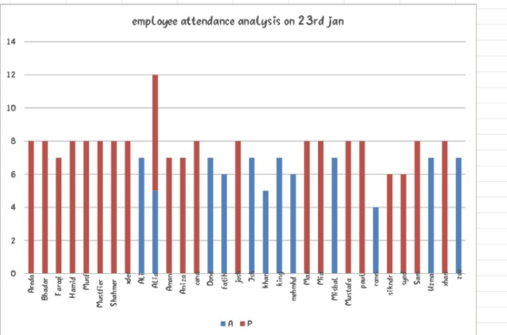
RESULTS
11

Slide 12
conclusion
the Excel based attendance analysis tool effectively organise and visualise employee attendance data, providing valuable insights into attendance pattern and trends. this enable better management decision, help address attendance issue proactively, and ultimately enhances overall workforce productivity.

